Slide 1
CSP554 Big Data Technologies
Module 13
NoSQL Databases: Cassandra

Slide 2


CASSANDRA
A.k.a Alexandra or Kassandra
Daughter of King Priam and Queen Hecuba of Troy.
Apollo gave her the power of prophecy to seduce her. She refused and then Apollo cursed her never to be believed.
https://en.wikipedia.org/wiki/Cassandra

Slide 3


CASSANDRA
Open Source distributed database management system
Initially developed at Facebook
Inspired by Amazon’s Dynamo and Google BigTable papers
Became Apache top-level project in Feb, 2010
Nowadays developed by DataStax

Slide 4
Cassandra
•
A Linearly Scaling and Fault Tolerant Distributed Database
•
Fully Distributed
Data spread over many nodes
All nodes participate in a cluster
All nodes are equal
No SPOF (shared nothing)
8

Slide 5


Two knobs control Cassandra fault tolerance
•
Replication Factor (server side)
– How many copies of the data should exist?
RF=3
A
CD
B
AD
Write A
Client
D
BC
C
AB

Slide 6


Two knobs control Cassandra fault tolerance
•
Consistency Level (client side)
– How many replicas do we need to hear from before we acknowledge?
CL=ONE CL=QUORUM
A
CD
B
AD
A
CD
B
AD
Write A
Write A
Client
Client
D
BC
C
AB
D
BC
C
AB

Slide 7
Consistency Levels
•
Applies to both Reads and Writes (i.e. is set on each query)
ONE – one replica from any DC LOCAL_ONE – one replica from local DC QUORUM – 51% of replicas from any DC
LOCAL_QUORUM – 51% of replicas from local DC
ALL – all replicas

Slide 8


Consistency Level and Speed
•
How many replicas we need to hear from can affect how quickly we can read and write data in Cassandra
A
CD
B
AD
Read A (CL=QUORUM)
Client
5 µs ack
300 µs ack
12 µs ack
D
BC
C
AB
12 µs ack

Slide 9
Consistency Level and Availability
•
•
Consistency Level choice affects availability
For example, QUORUM can tolerate one replica being down and still be available (in RF=3)
A
CD
B
AD
Read A (CL=QUORUM)
Client
A=2
A=2
A=2
D
BC
C
AB

Slide 10

Writes in the cluster
•
•
Fully distributed, no SPOF
Node that receives a request is the Coordinator for request
•
Any node can act as Coordinator
A
CD
B
AD
Client
Write A (CL=ONE)
D
BC
C
AB
Coordinator Node

Slide 11

Reads in the cluster
•
•
Same as writes in the cluster, reads are coordinated Any node can be the Coordinator Node
A
CD
B
AD
Client
Read A (CL=QUORUM)
D
BC
C
AB
Coordinator Node

Slide 12
Reads and Eventual Consistency
Cassandra is an AP system that is Eventually Consistent so replicas may disagree
Column values are timestamped
•
In Cassandra, Last Write Wins (LWW)
A
CD
B
AD
Read A
Client
(CL=QUORUM)
A=2
Newer
A=2
D
BC
C
AB
A=1
Older

Slide 13
Data Distribution
•
Partition Key determines node placement
CREATE TABLE users (
id text, firstname text, lastname text, PRIMARY KEY (id)
);
Partition Key
id='jhaddad'
firstname='Jon'
lastname='Haddad'
id='ltillman'
firstname='Luke'
lastname='Tillman'
id='pmcfadin'
lastname='McFadin'

Slide 14


Data Distribution
•
The Partition Key is hashed using a consistent hashing function and the output is used to place the data on a node
Partition Key
RF=3
id='ltillman'
firstname='Luke' lastname='Tillman'
A
CD
B
AD
id: ltillman
:A
D
BC
C
AB
•
The data is also replicated to RF-1 other nodes

Slide 15
Cassandra
•
Fault Tolerant
–
Nodes Down != Database Down
– Datacenter Down != Database Down

Slide 16




Cassandra
•
•
•
•
Fully Replicated Clients write local
Data syncs across WAN Replication Factor per DC
Client
US
Europe

Slide 17


Cassandra is great for...
Massive, linear scaling
(e.g. CERN hadron collider, Barracuda Networks)
Extremely heavy writes
(e.g. BlueMountain Capital – financial tick data)
High availability
(e.g. eBay, Eventbrite, Netflix, SoundCloud, HeathCare Anytime, Comcast, GoDaddy, Sony Entertainment Network)
©2012 DataStax
13

Slide 18
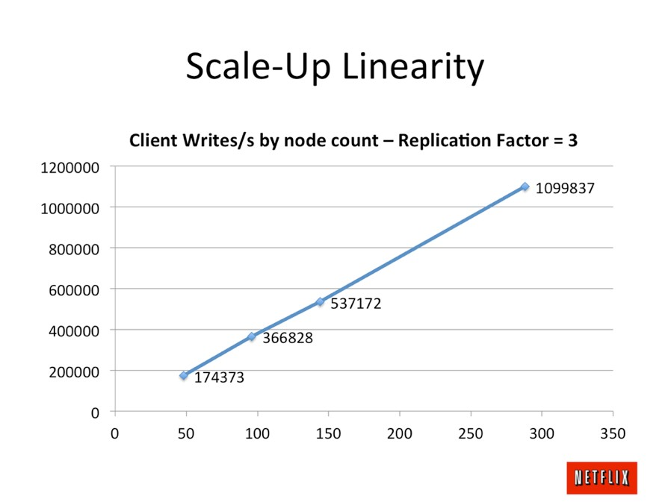
©2012 DataStax
14

Slide 19
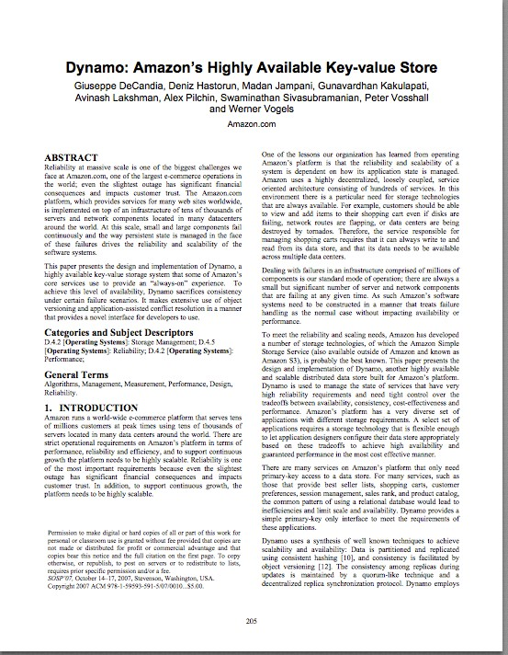

Dynamo Paper(2007)
How do we build a data store that is:
Reliable
Performant
“Always On”
Nothing new and shiny
24 papers cited
Also the basis for Riak and Voldemort

Slide 20
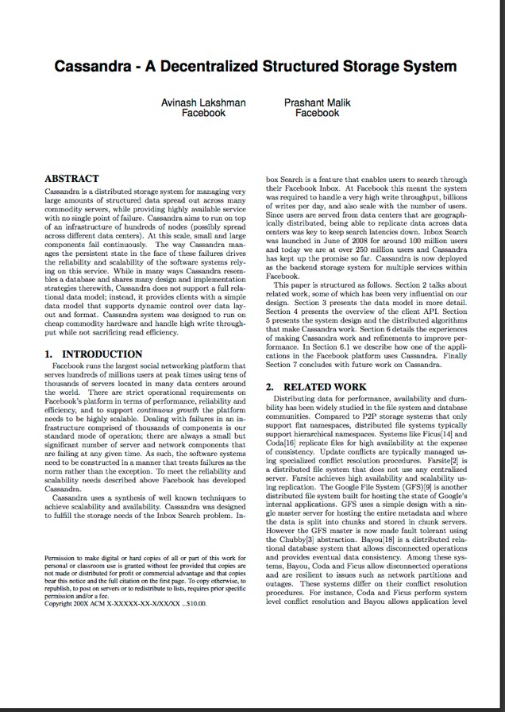
Cassandra(2008)
Distributed features of Dynamo
Data Model and storage from BigTable
February 17, 2010 it graduated to a top-level Apache project

Slide 21

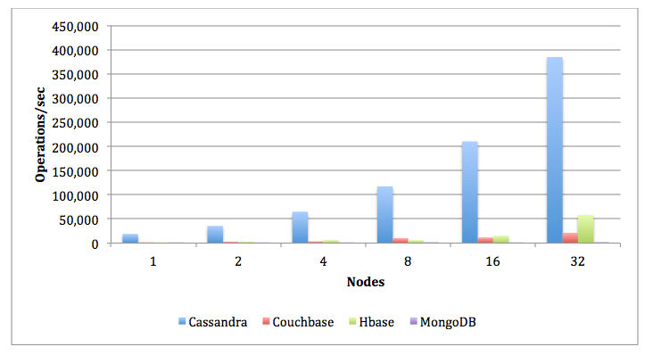
CASSANDRA
Fast Distributed NoSQL Database
High Availability
Linear Scalability => Predictability
No SPOF
Multi-DC
Horizontally scalable
Not a drop in replacement for RDBMS

Slide 22

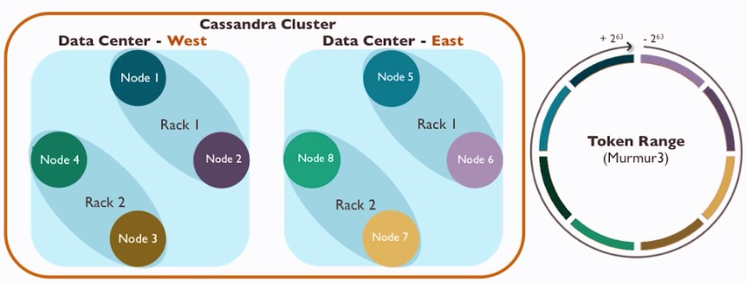
CASSANDRA CLUSTER

Slide 23
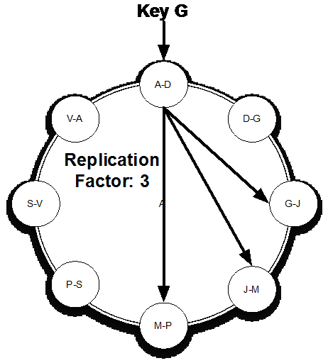
REPLICATION FACTOR
How many copies (replicas) for your data

Slide 24
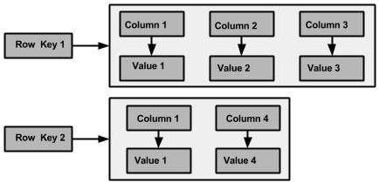
CASSANDRA DATA MODEL
Query driven data model
Column family non relational db

Slide 25



CQL
Familiar row-column SQL-like approach.
INSERT INTO users (id, name, surname, birthdate) VALUES (uuid(), ‘Carlos’,‘Alonso’, ’1985-03-19’);
CREATE TABLE users ( id UUID,
name VARCHAR, surname VARCHAR, birthdate TIMESTAMP, PRIMARY KEY(id)
);
SELECT * FROM users WHERE
id = ‘f81d4fae-7dec-11d0-a765-00a0c91e6bf6’;
ALTER TABLE users ADD address VARCHAR;

Slide 26
CASSANDRA:YES
If you need:
No SPOF
Linear horizontal scalability in commodity hardware
Real-time writes
Reliable data replication across distributed data centres
Clearly defined schema in a NoSQL environment

Slide 27
CASSANDRA: NO
If you need:
ACID transactions with rollback
Justification for high-end software

Slide 28
What do consistency, availability and partition tolerance mean?
Consistency: All clients have the exact same value for the whole data set at any given point.
Availability: All clients can read and write to the system at any given point.
Partition tolerance: Whether or not the system tolerates a node being disconnected from the system.

Slide 29
Where does Cassandra fit within the CAP Theorem?
AP
Cassandra trades off consistency in order to guarantee availability and partition tolerance, but in a configurable way, so it’s up to the developer where to sit for each query.

Slide 30
Which are the technological roots of Cassandra?
Google BigTable and Amazon Dynamo pulled together by developers at Facebook

Slide 31
What technology does Cassandra use to model data?
CQL: Cassandra Query Language

Slide 32
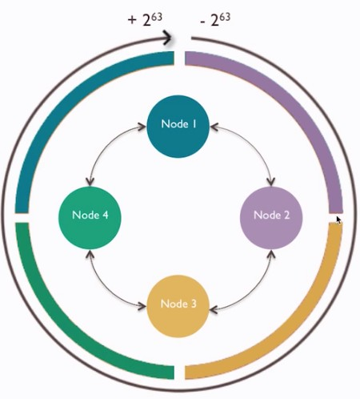
CONSISTENT HASHING
Data is stored in partitions, identified by a unique token within the range
(-2^63 - 2^63)
Nodes contain partition ranges.

Slide 33
THE PARTITIONER
System running on each node that computes hashes through a hash function.
Various partitioners available.
Default is murmur3
All nodes MUST use the same!!!!
“Carlos”
185664
Hash function
1773456738847666528349
-894763734895827651234

Slide 34
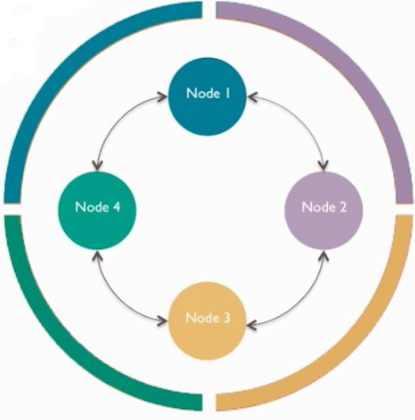
VNODES

Slide 35
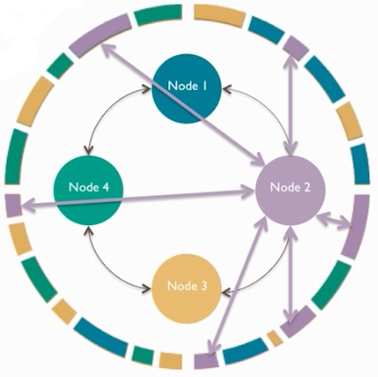
VNODES

Slide 36
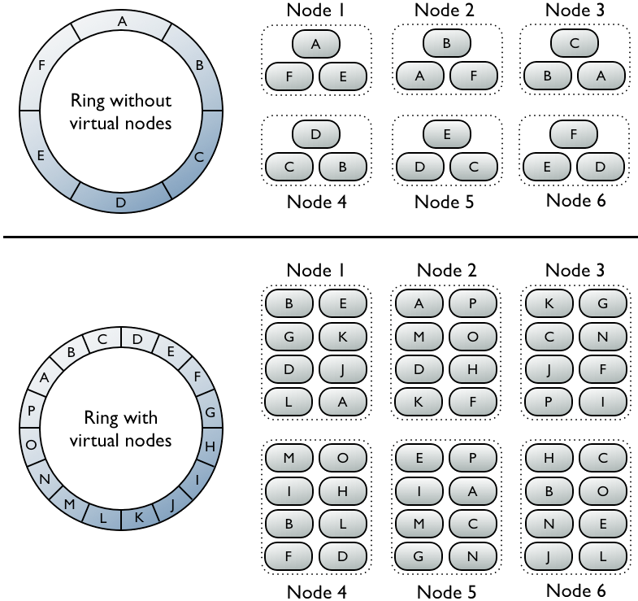

Slide 37
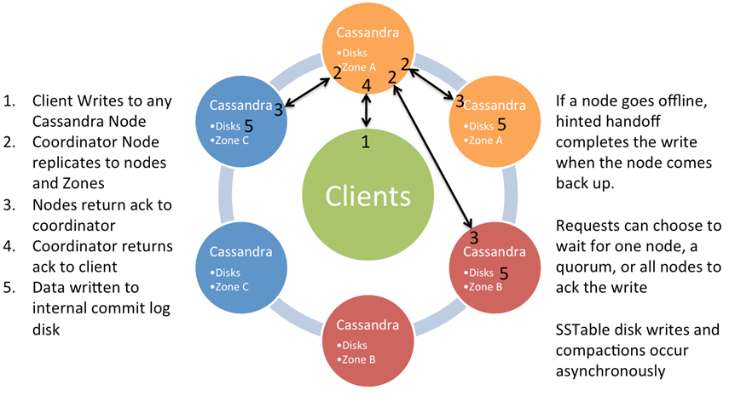
Write Behavior

Slide 38


CQL
Cassandra Query Language

Slide 39
Terminology
Keyspace
Keyspace is like RDBMS Database or Schema
Table, Row, Column
Like RDBMS, Cassandra uses tables, having rows with columns to store data
Partition (Key)
Partitions are grouping of table rows across multiple Cassandra nodes
Clustering Key (Optional)
Clusters are groupings of table rows on a node ordered by some attribute(s)

Slide 40
For Example
CREATE KEYSPACE packagetracker WITH REPLICATION = { 'class' : 'SimpleStrategy', 'replication_factor' : 1 };
CREATE KEYSPACE packagetracker WITH REPLICATION = { 'class' : 'NetworkTopologyStrategy', 'dc1' : 2, 'dc2' : 2};
CREATE TABLE events ( package_id text, status_timestamp timestamp, location text,
notes text,
PRIMARY KEY (package_id, status_timestamp)
);

Slide 41
Constructs

Slide 42
Basic Data Types
blob
int
text
long
uuid
etc

Slide 43
More Data Modeling Constructs
Collections
map, set, list
Time to live (TTL)
Counters
Secondary Indexes

Slide 44
Approaching Data Modeling
Model your queries, not your data
Optimize your data model for reads
Don’t be afraid to denormalize
You will get it wrong, iterate

Slide 45
An Example: User Logins

Slide 46
The Table and a Query
What are the last 10 locations nickmbailey logged in from?
CREATE TABLE logins (
user text,
time timestamp,
location text,
PRIMARY KEY (user, time));
SELECT time, location FROM logins
WHERE user = ‘nickmbailey’
ORDER BY time DESC LIMIT 10;

Slide 47
Partition Keys(s)
What are the last 10 locations nickmbailey logged in from?
CREATE TABLE logins (
user text,
time timestamp,
location text,
PRIMARY KEY (user, time));
SELECT time, location FROM logins
WHERE user = ‘nickmbailey’
ORDER BY time DESC LIMIT 10;
Partition Key

Slide 48
Cluster Key(s)
What are the last 10 locations nickmbailey logged in from?
CREATE TABLE logins (
user text,
time timestamp,
location text,
PRIMARY KEY (user, time));
SELECT time, location FROM logins
WHERE user = ‘nickmbailey’
ORDER BY time DESC LIMIT 10;
Cluster Key

Slide 49
Non-Key Attributes (Columns)
What are the last 10 locations nickmbailey logged in from?
CREATE TABLE logins (
user text,
time timestamp,
location text,
PRIMARY KEY (user, time));
SELECT time, location FROM logins
WHERE user = ‘nickmbailey’
ORDER BY time DESC LIMIT 10;
Other Columns

Slide 50
Partition and Cluster Keys
What are the last 10 locations nickmbailey logged in from?
SELECT time, location FROM logins WHERE user = ‘nickmbailey’ ORDER BY time DESC LIMIT 10;
CREATE COLUMN FAMILY logins (
user text, time timestamp, location text,
PRIMARY KEY (user, time));
Partition Key Cluster Key
 | User |  | Time | Location
 | nickmbailey |  | 2013-07-19 09:22:18 | Austin, Texas
 | nickmbailey |  | 2013-07-19 14:49:27 | Blacksburg, Virginia
 | jsmith |  | 2013-07-20 07:59:34 | Atlanta, Georgia

Slide 51
Time-series data
By far, the most common data model
Event logs
Metrics
Sensor Data
Etc

Slide 52
Another Query
When was the last time nickmbailey logged in from San Francisco, California?
SELECT time FROM logins WHERE user = ‘nickmbailey’ and location=‘San Francisco, California’;
User | Time | Location
nickmbailey | 2013-07-19 09:22:18 | Austin, Texas
nickmbailey | 2013-07-19 14:49:27 | Blacksburg, Virginia
nickmbailey | 2013-07-19 14:49:27 | Austin, Texas
nickmbailey | 2013-05-19 14:49:27 | Austin, Texas
nickmbailey | 2013-04-19 14:49:27 | San Francisco, California
... | ... | ...
jsmith | 2013-07-20 07:59:34 | Atlanta, Georgia

Slide 53
Another Query
When was the last time nickmbailey logged in from Austin, Texas?
SELECT time FROM logins_by_location WHERE user = ‘nickmbailey’ and location=‘San Francisco, California’;
CREATE COLUMN FAMILY logins_by_location ( user text,
time timestamp, location text,
PRIMARY KEY (user, location));

Slide 54
Another Query
When was the last time nickmbailey logged in from Austin, Texas?
SELECT time FROM logins_by_location WHERE user = ‘nickmbailey’ and location=‘San Francisco, California’;
CREATE COLUMN FAMILY logins_by_location ( user text,
time timestamp, location text,
PRIMARY KEY (user, location));
User | Location | Time
nickmbailey | Austin, Texas | 2013-07-19 09:22:18
nickmbailey | Blacksburg, Virginia | 2013-07-19 14:49:27
nickmbailey | San Francisco, California | 2013-07-19 14:49:27

Slide 55
Denormalize
Create materialized views of the same data to support different queries
Storage space is cheap, Cassandra is fast

Slide 56


Schema Definition (DDL)
Easy to define tables for storing data
First part of Primary Key is the Partition Key
•
•
CREATE TABLE videos ( videoid uuid, userid uuid,
name text, description text, tags set<text>, added_date timestamp, PRIMARY KEY (videoid)
);

Slide 57



Schema Definition (DDL)
videoid
name
...
689d56e5-
…
Keyboard Cat
...
CREATE TABLE videos ( videoid uuid, userid uuid,
name text, description text, tags set<text>, added_date timestamp, PRIMARY KEY (videoid)
);
93357d73-
…
Nyan Cat
...
d978b136-
…
Original Grumpy Cat
...

Slide 58


Clustering Columns
•
Second part of Primary Key is Clustering Columns
CREATE TABLE comments_by_video ( videoid uuid,
commentid timeuuid, userid uuid, comment text,
PRIMARY KEY (videoid, commentid)
) WITH CLUSTERING ORDER BY (commentid DESC);
Clustering columns affect ordering of data (on disk) Multiple rows per partition
•
•
28

Slide 59

Clustering Columns
videoid | commentid | ...
689d56e5- … | 8982d56e5… | ...
689d56e5- … | 93822df62… | ...
689d56e5- … | 22dt62f69… | ...
93357d73- … | 8319af913...
29

Slide 60



Inserts and Updates
•
Use INSERT or UPDATE to add and modify data
INSERT INTO comments_by_video (
videoid, commentid, userid, comment)
VALUES (
'0fe6a...', '82be1...', 'ac346...', 'Awesome!');
UPDATE comments_by_video
SET userid = 'ac346...', comment = 'Awesome!' WHERE videoid = '0fe6a...' AND commentid = '82be1...';

Slide 61




Deletes
•
Can specify a Time to Live (TTL) in seconds when doing an INSERT or UPDATE
INSERT INTO comments_by_video ( ... )
VALUES ( ... )
USING TTL 86400;
•
Use DELETE statement to remove data
DELETE FROM comments_by_video
WHERE videoid = '0fe6a...' AND commentid = '82be1...';

Slide 62


Querying
•
Use SELECT to get data from your tables
SELECT * FROM comments_by_video WHERE videoid = 'a67cd...' LIMIT 10;
•
Always include Partition Key and optionally Clustering Columns
Can use ORDER BY and LIMIT
•
•
Use range queries (for example, by date) to slice partitions

Slide 63
Cassandra Data Modeling
•
Hmmm, looks like SQL, I know that…

Slide 64
Cassandra Data Modeling
•
Requires a different mindset than RDBMS modeling
Know your data and your queries up front
Queries drive a lot of the modeling decisions (i.e. “table per query” pattern)
Denormalize/Duplicate data at write time to do as few queries as possible come read time
Remember, disk is cheap and writes in Cassandra are
FAST
•
•
•
•

Slide 65
Other Data Modeling Concepts
•
Lightweight Transactions
JSON
User Defined Types User Defined Functions
•
•

Slide 66
Accessing CQL
Common ways to access CQL are:
For open source and commercial installations, start cqlsh, the Python-based command-line client, on the command line of a Cassandra node
For commercial installations only, use DataStax DevCenter, a graphical user interface

Slide 67

CQLSH
Our data management and first exploration tool

Slide 68
CQLSH
help: shows available cqlsh + CQL commands
DESCRIBE: shows information of the arguments
SOURCE: executes a file containing CQL statements
TRACING: enables/disables the tracing mode
SELECT, ALTER, INSERT, …

Slide 69
CQL Lexical Structure
CQL input consists of statements
Like SQL, statements change data, look up data, store data, or change the way data is stored
Statements end in a semicolon (;)
For example, the following is valid CQL syntax:
SELECT * FROM MyTable;
UPDATE MyTable
SET SomeColumn = 'SomeValue'
WHERE columnName = ‘SomeColumnName’;
This is a sequence of two CQL statements

Slide 70
CQL Lexical Structure
Identifiers created using CQL are case-insensitive unless enclosed in double quotation marks
If you enter names for these objects using any uppercase letters, Cassandra stores the names in lowercase
You can force the case by using double quotation marks. For example:
CREATE TABLE test (
Foo int PRIMARY KEY, <= Foo is stored as foo
"Bar" int <= Bar is stored as Bar
);

Slide 71
CQL Lexical Structure
What Works and What Doesn't
Queries that Work Queries that Don't Work
SELECT foo FROM . . . SELECT "Foo" FROM . . .
SELECT Foo FROM . . . SELECT "BAR" FROM . . .
SELECT FOO FROM . . . SELECT bar FROM . . .
SELECT "Bar" FROM . . . SELECT Bar FROM . . .
SELECT "foo" FROM . . . SELECT "bar" FROM . . .
SELECT "foo" FROM ... works because internally, Cassandra stores foo in lowercase

Slide 72
CQL Lexical Structure
CQL keywords are case-insensitive
For example, the keywords SELECT and select are equivalent

Slide 73
CQL Code Comments
Use the following notation to include comments in CQL code
For a single line or end of line put a double hyphen before the text, this comments out the rest of the line:
select * from cycling.route; -- End of line comment
For a single line or end of line put a double forward slash before the text, this comments out the rest of the line:
select * from cycling.route; // End of line comment
For a block of comments put a forward slash asterisk at the beginning of the comment and then asterisk forward slash at the end
/* This is the first line of a comment that spans multiple lines */
select * from cycling.route;

Slide 74
CREATE KEYSPACE
Creates a top-level namespace
Configure the replica placement strategy, replication factor, and durable writes setting
CREATE KEYSPACE [IF NOT EXISTS] keyspace_name
WITH REPLICATION = {
'class' : 'SimpleStrategy', 'replication_factor' : N }
| 'class' : 'NetworkTopologyStrategy',
'dc1_name' : N [, ...]
}
[AND DURABLE_WRITES = true|false] ;

Slide 75
CREATE KEYSPACE
CREATE KEYSPACE [IF NOT EXISTS]
keyspace_nameKeyspace names can have up to 48 alpha-numeric characters and contain underscores; only letters and numbers are supported as the first character
Cassandra forces keyspace names to lowercase when entered without quotes
If a keyspace with the same name already exists, an error occurs and the operation fails
Use IF NOT EXISTS to suppress the error message.

Slide 76
CREATE KEYSPACE
REPLICATION = { replication_map }
The replication map determines how many copies of the data are kept in a given data center
This setting impacts consistency, availability and request speed
Replication strategy class and factor settings
Class | Replication factor | Value Description
'SimpleStrategy' | 'replication_factor' : N | Assign the same replication factor to the entire cluster
'NetworkTopologyStrategy' | 'datacenter_name' : N | Assign replication factors to each data center in a comma separated list. Use in production environments and multi-DC test and development environments.

Slide 77
CREATE KEYSPACE
Simple Topolgy syntax:
'class' : 'SimpleStrategy', 'replication_factor' : N
Network Topology syntax
'class' : 'NetworkTopologyStrategy', 'dc1_name' : N [, ...]
DURABLE_WRITES = true|false
Optionally bypass the commit log when writing to the keyspace by disabling durable writes.
Default value is true.

Slide 78
CREATE KEYSPACE
Create cycling keyspace on a single node evaluation cluster:
CREATE KEYSPACE cycling WITH REPLICATION = { 'class' : 'SimpleStrategy', 'replication_factor' : 1 };

Slide 79
CREATE KEYSPACE
Create the cycling keyspace in an environment with mutliple data centers
Set the replication factor for the Boston, Seattle, and Tokyo data centers
CREATE KEYSPACE "Cycling"
WITH REPLICATION = {
'class' : 'NetworkTopologyStrategy',
'boston' : 3 , // Datacenter 1
'seattle' : 2 , // Datacenter 2
'tokyo' : 2 , // Datacenter 3
};

Slide 80
REPLICATION
How many copies of your data?

Slide 81
WHY REPLICATION?
Disaster recovery
Bring data closer to users (to reduce latencies)
Workload segregation (analytical vs transactional)

Slide 82


REPLICATION
Defined at keyspace level
CREATE KEYSPACE <my_keyspace> WITH REPLICATION =
{ “class”: “SimpleStrategy”, “replication_factor”: 2 };
CREATE KEYSPACE <my_keyspace> WITH REPLICATION =
{ “class”: “NetworkTopologyStrategy”, “dc-east”: 2, “dc-west”: 3 };

Slide 83

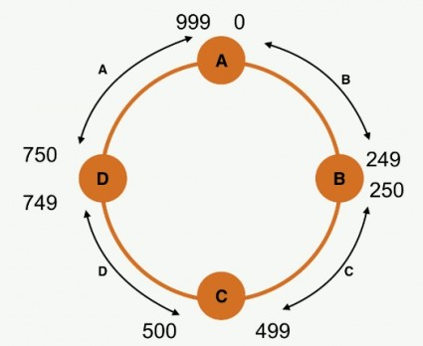
SIMPLESTRATEGY
CREATE KEYSPACE <my_keyspace> WITH REPLICATION =
{ “class”: “SimpleStrategy”, “replication_factor”: 3 };
Token: 834
Client
Driver

Slide 84
SIMPLESTRATEGY
CREATE KEYSPACE <my_keyspace> WITH REPLICATION =
{ “class”: “SimpleStrategy”, “replication_factor”: 3 };
Token: 834
Client
Driver

Slide 85
SIMPLESTRATEGY
CREATE KEYSPACE <my_keyspace> WITH REPLICATION =
{ “class”: “SimpleStrategy”, “replication_factor”: 3 };
Token: 834
Client
Driver

Slide 86
SIMPLESTRATEGY
CREATE KEYSPACE <my_keyspace> WITH REPLICATION =
{ “class”: “SimpleStrategy”, “replication_factor”: 3 };
Token: 834
Client
Driver

Slide 87

NETWORKTOPOLOGYSTRATEGY
CREATE KEYSPACE <my_keyspace> WITH REPLICATION =
{ “class”: “NetworkTopologyStrategy”, “dc-east”: 2,“dc-west”: 3 };
dc-west dc-east
Client Driver
rack-1
rack-1
Token: 834
rack-2
rack-2

Slide 88
@calonso
NETWORKTOPOLOGYSTRATEGY
CREATE KEYSPACE <my_keyspace> WITH REPLICATION =
{ “class”: “NetworkTopologyStrategy”, “dc-east”: 2,“dc-west”: 3 };
dc-west dc-east
Client Driver
rack-1
rack-1
Token: 834
rack-2
rack-2

Slide 89
NETWORKTOPOLOGYSTRATEGY
CREATE KEYSPACE <my_keyspace> WITH REPLICATION =
{ “class”: “NetworkTopologyStrategy”, “dc-east”: 2,“dc-west”: 3 };
dc-west dc-east
Client Driver
rack-1
rack-1
Token: 834
rack-2
rack-2

Slide 90
NETWORKTOPOLOGYSTRATEGY
CREATE KEYSPACE <my_keyspace> WITH REPLICATION =
{ “class”: “NetworkTopologyStrategy”, “dc-east”: 2,“dc-west”: 3 };
dc-west dc-east
Client Driver
rack-1
rack-1
Token: 834
rack-2
rack-2

Slide 91
NETWORKTOPOLOGYSTRATEGY
CREATE KEYSPACE <my_keyspace> WITH REPLICATION =
{ “class”: “NetworkTopologyStrategy”, “dc-east”: 2,“dc-west”: 3 };
dc-west dc-east
Client Driver
rack-1
rack-1
Token: 834
rack-2
rack-2

Slide 92
CREATE TABLE
The CREATE TABLE command creates a new table under a keyspace
CREATE TABLE [IF NOT EXISTS] [keyspace_name.]table_name (
column_definition [, ...]
PRIMARY KEY (column_name [, column_name ...])
[WITH table_options
| CLUSTERING ORDER BY (clustering_column_name order])
| ID = 'table_hash_tag'
| COMPACT STORAGE]

Slide 93
Primary Key | Single Key
When the PRIMARY KEY is one column, append PRIMARY KEY to the end of the column definition
This is only schema information required to create a table
When there is one primary key, it is the partition key; the data is divided and stored by the unique values in this column:
column_name cql_type_definition PRIMARY KEY
Alternatively, you can declare the primary key consisting of only one column in the same way as you declare a compound primary key
Create the cyclist_name table with UUID as the primary key
CREATE TABLE cycling.cyclist_name (
id UUID PRIMARY KEY,
lastname text,
firstname text
);

Slide 94
Primary Key | Compound Key
A compound primary key consists of more than one column
The first column is the partition key, and the additional columns are clustering keys
To define compound primary key as follows
PRIMARY KEY (partition_column_name, clustering_column_name [, ...])

Slide 95
CREATE TABLE
Create the cyclist category table and store the data in reverse order:
CREATE TABLE cycling.cyclist_category (
category text,
points int,
id UUID,
lastname text,
PRIMARY KEY (category, points))
WITH CLUSTERING ORDER BY (points DESC);

Slide 96
CREATE INDEX
Define a new index on a single column of a table
CREATE INDEX IF NOT EXISTS index_name
ON keyspace_name.table_name ( KEYS ( column_name ) )
If data already exists for the column, Cassandra indexes the data during the execution of this statement
After the index is created, Cassandra indexes new data for the column automatically when new data is inserted

Slide 97
CREATE TABLE | CREATE INDEX
Define a table and then create an index on two of its columns:
CREATE TABLE myschema.users (
userID uuid,
fname text,
lname text,
email text,
address text,
zip int,
state text,
PRIMARY KEY (userID)
);
CREATE INDEX user_state ON myschema.users (state);
CREATE INDEX ON myschema.users (zip);

Slide 98
INSERT
Inserts an entire row or upserts data into an existing row, using the full primary key
INSERT INTO [keyspace_name.] table_name (column_list)
VALUES (column_values)
[IF NOT EXISTS]
[USING TTL seconds | TIMESTAMP epoch_in_microseconds]
Requires a value for each component of the primary key, but not for any other columns
Missing values are set to null
INSERT returns no results unless IF NOT EXISTS is used.

Slide 99
INSERT
Insert a cyclist name using both a TTL and timestamp.
INSERT INTO cycling.cyclist_name (id, lastname, firstname)
VALUES (6ab09bec-e68e-48d9-a5f8-97e6fb4c9b47, 'KRUIKSWIJK','Steven')
USING TTL 86400 AND TIMESTAMP 123456789;
Add IF NOT EXISTS to ensure that the operation is not done if a row with the same primary key already exists:
INSERT INTO cycling.cyclist_name (id, lastname, firstname)
VALUES (c4b65263-fe58-4846-83e8-f0e1c13d518f, 'RATTO', 'Rissella')
IF NOT EXISTS;

Slide 100
SELECT
Returns one or more rows from a single Cassandra table
Although a select statement without a where clause returns all rows from all partitions, it is not recommended
SELECT * | select_expression | DISTINCT partition
FROM [keyspace_name.] table_name
[WHERE partition_value
[AND clustering_filters
[AND static_filters]]]
[ORDER BY PK_column_name ASC|DESC]
[LIMIT N]
[ALLOW FILTERING]

Slide 101
SELECT
The FROM clause specifies the table to query
You may want to precede the table name with the name of the keyspace followed by a period (.)
If you do not specify a keyspace, Cassandra queries the current keyspace
The following example returns the number of rows in the IndexInfo table in the system keyspace:
SELECT COUNT(*)
FROM system.IndexInfo;

Slide 102
SELECT
The LIMIT option sets the maximum number of rows that the query returns:
SELECT lastname
FROM cycling.cyclist_name
LIMIT 50000;
Even if the query matches 105,291 rows, Cassandra only returns the first 50,000
The cqlsh shell has a default row limit of 10,000
The Cassandra server and native protocol do not limit the number of returned rows

Slide 103
SELECT
The WHERE clause introduces one or more relations that filter the rows returned by SELECT
The column specification of the relation must be one of the following:
One or more members of the partition key of the table
A clustering column, only if the relation is preceded by other relations that specify all columns in the partition key
A column that is indexed using CREATE INDEX

Slide 104
SELECT
For example, the following table definition defines id as the table's partition key:
CREATE TABLE cycling.cyclist_career_teams ( id UUID PRIMARY KEY, lastname text, teams set<text> );
In this example, the SELECT statement includes in the partition key, so the WHERE clause can use the id column:
SELECT id, lastname, teams
FROM cycling.cyclist_career_teams
WHERE id=5b6962dd-3f90-4c93-8f61-eabfa4a803e2;
Restriction: a relation that references the partition key can only use an equality operator (= or IN)

Slide 105
SELECT
Use a relation on a clustering column only if it is preceded by relations that reference all the elements of the partition key
CREATE TABLE cycling.cyclist_points (
id UUID,
firstname text,
lastname text,
race_title text,
race_points int,
PRIMARY KEY (id, race_points ));
SELECT sum(race_points)
FROM cycling.cyclist_points
WHERE id=e3b19ec4-774a-4d1c-9e5a-decec1e30aac
AND race_points > 7;

Slide 106
CQL Constraints
CQL has many restrictions in comparison to SQL
These restrictions prevent inefficient querying across a distributed database
CQL queries should not visit a large number of nodes to retrieve required data
This has the potential to impact cluster-wide performance

Slide 107
CQL Constraints
Thus CQL prevents the following…
No arbitrary WHERE clause – Apache Cassandra prevents arbitrary predicates in a WHERE statement. Where clauses must have columns specified in your primary key.
No JOINS – You cannot join data from two Apache Cassandra tables.
No arbitrary GROUP BY – GROUP BY can only be applied to a partition or cluster column. Apache Cassandra 3.10 added GROUP BY support to SELECT statements.
No arbitrary ORDER BY clauses – Order by can only be applied to a clustered column.

Slide 108
Example
We need to build a system for an online electronic books reading site.

Slide 109

Example
We need to build a system for an online electronic books reading site.
CREATE KEYSPACE e_library WITH REPLICATION =
{ “class”: “SimpleStrategy”, “replication_factor”: 3};

Slide 110

DDL
CREATE TABLE performer ( name VARCHAR,
type VARCHAR, country VARCHAR, style VARCHAR, founded INT,
born TIMESTAMP, died TIMESTAMP, PRIMARY KEY (name)
);

Slide 111
PRIMARY KEY
PARTITION KEY +
CLUSTERING COLUMN(S)
+

Slide 112
PRIMARY KEY
Simple partition key, no clustering columns:
PRIMARY KEY (name)
Composite partition key, no clustering columns:
PRIMARY KEY ((album_title, year))
Simple partition key and clustering columns:
PRIMARY KEY (album_title, number)
Composite partition key and clustering columns:
PRIMARY KEY ((album_title, year), number)

Slide 113
PRIMARY KEYS
CREATE TABLE albums_by_track ( track_title VARCHAR,
performer VARCHAR, year INT,
album_title VARCHAR, PRIMARY KEY (
track_title, performer, year, album_title)
);
CREATE TABLE tracks_by_album ( album_title VARCHAR,
year INT,
performer VARCHAR STATIC, genre VARCHAR STATIC,
number INT, track_title VARCHAR,
PRIMARY KEY ((album_title, year), number)
);

Slide 114
CQL TYPE | Constants | Description
ASCII | strings | US-ASCII character strings
BIGINT | integers | 64-bit signed long
BLOB | blobs | Arbitrary bytes (no validation), as hexadecimal
BOOLEAN | booleans | true or false
COUNTER | integers | Distributed counter value (64 bit long)
DECIMAL | integers or floats | Variable precision decimal
DOUBLE | integers | 64-bit IEEE-754 floating point
FLOAT | integers, floats | 32-bit IEEE-754 floating point
INT | integers | 32-bit signed integer
LIST | n/a | A collection of one or more ordered elements
MAP | n/a | A JSON style array of literals { literal: literal, literal: literal, …}
SET | n/a | A collection of one or more elements
TEXT | strings | UTF-8 encoded text
TIMESTAMP | integers, strings | Date + time as mills since EPOCH
UUID | uuids | Standard UUID
VARCHAR | strings | UTF-8 encoded string
VARINT | integers | Arbitrary precision integer
TIMEUUID | uuids | Type I UUID

Slide 115

INSERT
INSERT INTO albums_by_performer (performer, year, title, genre) VALUES (‘The Beatles’, 1966, ‘Revolver’, ‘Rock’);
CQL INSERTS are:
Atomic: Either all the values are inserted or none
Isolated:Two inserts on the exact same PK happen one after the other, no mixed values.

Slide 116

UPDATE
UPDATE albums_by_performer SET genre = ‘Rock’
WHERE performer = ‘The Beatles’ AND year = 1966 AND
title = ‘Revolver’;
Primary Key columns cannot be changed.
Full Primary key is required as predicate.
CQL UPDATES are:
Atomic: Either all the values are inserted or none
Isolated:Two inserts on the exact same PK happen one after the other, no mixed values.

Slide 117

UPSERT
INSERT INTO albums_by_performer (performer, year, title, genre) VALUES (‘The Beatles’, 1966, ‘Revolver’, ‘Rock’);
==
UPDATE albums_by_performer SET genre = ‘Rock’
WHERE performer = ‘The Beatles’ AND year = 1966 AND
title = ‘Revolver’;

Slide 118
Example
We need to design a system that holds users. Users will have name, ID card (unique), a phones list (home, mobile and work), birth date and an email address.
NOTE: As we haven’t studied SELECT, use
SELECT * FROM <table name>; to inspect your data.

Slide 119

Example
CREATE TABLE users (
ID VARCHAR PRIMARY KEY,
name VARCHAR, home_phone VARCHAR, work_phone VARCHAR, mobile_phone VARCHAR, email VARCHAR,
birth_date TIMESTAMP
);

Slide 120
MORE DDL
ALTER TABLE album ADD cover_image VARCHAR;
ALTER TABLE album ALTER cover_image TYPE BLOB;
ALTER TABLE album DROP cover_image;

Slide 121

MORE DDL
CREATE TABLE albums_by_genre ( genre VARCHAR,
performer VARCHAR, year INT,
album_title VARCHAR, PRIMARY KEY (
genre, performer, year, album_title)
) WITH CLUSTERING ORDER BY
(performer ASC, year DESC, title ASC);

Slide 122
SECONDARY INDEXES
Tables are indexed on columns in a PK
Search on a partition key is very efficient
Search on a PK and Clustering column is very efficient
Search on other things is not supported
Secondary indexes allow indexing other columns to be queried.
One index per column

Slide 123



SECONDARY INDEXES
CREATE TABLE performer ( name VARCHAR,
type VARCHAR, country VARCHAR, style VARCHAR, founded INT,
born TIMESTAMP, died TIMESTAMP, PRIMARY KEY (name)
);
CREATE INDEX performers_by_style ON perfomer (style);
DROP INDEX performers_by_style;

Slide 124
SECONDARY INDEXES
Same recommendations for RDBMS
Use indexes on low cardinality fields
Beware of the write overhead
Every node indexes it local data therefore => a read hits all nodes!!
Don’t use them. Use lookup tables instead.

Slide 125
Example
We need to query the users by name.

Slide 126

Example
We need to query the users by name.
CREATE INDEX users_by_name ON users (name);

Slide 127
UUID
Type 4 UUID
Our way to ensure uniqueness in a distributed system.
7ffa4040-9132-4e0b-b04f-610e869d8717

Slide 128
Example
Our system has another entity: Books. Books have a title and an author.
We have no guarantee of any of them or even their combination to be unique.

Slide 129

Example
Our system has another entity: Books. Books have a title and an author.
We have no guarantee of any of them or even their combination to be unique.
CREATE TABLE books (
uid TIMEUUID PRIMARY KEY,
title VARCHAR, author VARCHAR
);

Slide 130
TIMEUUID
Timestamp + UUID
c9cc9e60-711c-11e5-9d70-feff819cdc9f
Type 1 UUID
Generated with CQL now() function
Can extract the Timestamp with CQL dateof() function

Slide 131
TIMEUUID
Timestamp + UUID
Type 1 UUID
c9cc9e60-711c-11e5-9d70-feff819cdc9f
Generated with CQL now() function
Can extract the Timestamp with CQL dateof() function

Slide 132

TIMEUUID
CREATE TABLE track_ratings_by_user (
user UUID,
activity TIMEUUID,
rating INT,
album_title VARCHAR,
album_year INT, track_title VARCHAR,
PRIMARY KEY (user, activity)
) WITH CLUSTERING ORDER (activity DESC);

Slide 133

TTL
INSERT INTO albums_by_performer (performer, year, title, genre) VALUES (‘The Beatles’, 1966, ‘Revolver’, ‘Rock’) USING TTL 30;
Time To Live for columns specified in seconds.
After TTL expires, column is marked with a Tombstone.

Slide 134
Example
We are in the BigData era and therefore we want to measure absolutely everything our users do in our portal. Actions will be defined by a type (string) and a receiver (int).

Slide 135

Example
We are in the BigData era and therefore we want to measure absolutely
everything our users do in our portal. Actions will be defined by a type (string)
and a receiver (int).
CREATE TABLE user_action ( user_ID VARCHAR,
time TIMESTAMP,
type VARCHAR, receiver INT,
PRIMARY KEY(user_ID, time)
);

Slide 136
DELETE
A whole partition:
DELETE FROM <table> WHERE <partition_key> = value;
A row:
DELETE FROM <table> WHERE <primary key> = value;
A column:
DELETE <column name> FROM <table> WHERE <primary key> = value;
Deleted things are marked with a tombstone, not actually removed.

Slide 137

TRUNCATE
TRUNCATE albums_by_performer;

Slide 138
TIMEUUID
Timestamp + UUID
Type 1 UUID
c9cc9e60-711c-11e5-9d70-feff819cdc9f
Generated with CQL now() function
Can extract the Timestamp with CQL dateof() function

Slide 139
COLLECTIONS
Our users can have several email addresses…
Set: Uniqueness
email_addresses SET<VARCHAR>
List: Order
email_addresses LIST<VARCHAR>
Map: Key-Value pairs
email_addresses MAP<VARCHAR, VARCHAR>

Slide 140
SETS
Insert:
INSERT INTO band (name, members) VALUES (‘The Beatles’, {‘John’, ’Paul’, ‘George’});
Union (duplicates deletion managed transparently):
UPDATE band SET members = members + {‘John’, ’Ringo’} WHERE name = ‘The Beatles’;
Difference:
UPDATE band SET members = members - {‘Ringo’} WHERE name = ‘The Beatles’;
Deletion:
DELETE members FROM band WHERE name = ‘The Beatles’;

Slide 141

LISTS
CREATE TABLE song (
name VARCHAR
songwriters LIST<VARCHAR>, PRIMARY KEY (name)
);
Insert:
INSERT INTO song (name, songwriters) VALUES (‘Hold your hand’, [‘John’, ’Paul’]);
Append:
UPDATE song SET songwriters = songwriters +[‘Paul’] WHERE name = …;

Slide 142
LISTS
Prepend:
UPDATE song SET songwriters = [‘Paul’] + songwriters WHERE name = …;;
Update:
UPDATE song SET songwriters[1] = ‘Jonathan’ WHERE name = …;
Subtract
UPDATE song SET songwriters = songwriters - [‘Jonathan’] WHERE name = …;
Delete
DELETE songwriters[0] FROM song WHERE name = …;

Slide 143

MAPS
Insert:
INSERT INTO album (title, tracks) VALUES (‘Revolver’,
{ 1: ’Taxman’, 2: ‘Eleanor’});
Update:
UPDATE album SET tracks[3] = ‘Yellow Submarine’ WHERE title = …;
CREATE TABLE album (
title VARCHAR,
tracks MAP<INT,VARCHAR>, PRIMARY KEY (title)
);
Delete:
DELETE tracks[3] FROM album WHERE title = …;

Slide 144
Example
Our users can define a set of preferences in the portal: TimeZone, Language and Currency

Slide 145
Example
Our users can define a set of preferences in the portal: TimeZone, Language and Currency
ALTER TABLE users ADD preferences MAP<VARCHAR,VARCHAR>;

Slide 146
SELECT
All rows:
SELECT * FROM album;
Specific columns:
SELECT performer, title, year FROM album;
Specific field from a UDT:
SELECT performer.lastname FROM album;
Count:
SELECT COUNT(*) FROM album;

Slide 147
WHERE
Equality matches:
SELECT * FROM tracks_by_album WHERE album_title = ‘Revolver’ AND year = 1966;
SELECT * FROM tracks_by_album WHERE album_title = ‘Revolver’ AND year = 1966 AND number = 6;
IN:
Only applicable in the last WHERE clause
SELECT * FROM tracks_by_album WHERE album_title = ‘Revolver’ AND year = 1966 AND number IN (2, 3, 4);

Slide 148
WHERE
Range search:
Only on clustering columns.
SELECT * FROM tracks_by_album WHERE album_title = ‘Revolver’ AND year = 1966 AND number >= 6 AND number < 2;
ALLOW FILTERING:
Allows scanning through all partitions => potentially very time consuming
SELECT * FROM tracks_by_album WHERE number = 2 ALLOW FILTERING;

Slide 149
DATA MODELLING
Processes and good practices to design our schema.

Slide 150
DATA MODELLING
Understand your data
Decide how you’ll query the data
Define column families to satisfy those queries
Implement and optimize

Slide 151
DATA MODELLING
Conceptual Model
Query-Driven Methodology
Logical Model
Analysis & Validation
Physical Model

Slide 152
DATA MODELLING
E-R
Diagram
Query-Driven Methodology
Chebotko Diagram
Analysis & Validation
Physical-level Chebotko Diagram

Slide 153
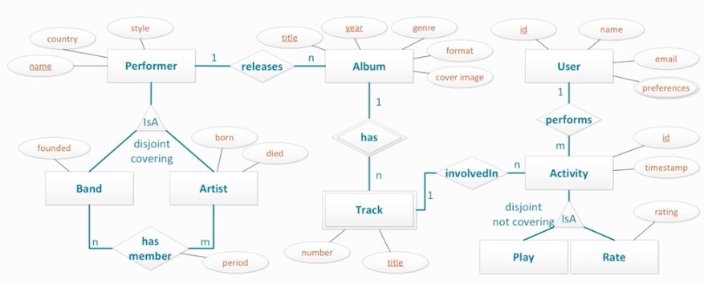
CONCEPTUAL MODEL

Slide 154
QUERY DRIVEN METHODOLOGY
Spread data evenly around the cluster
Minimize the number of partitions read
Follow the mapping rules:
Entities and relationships: map to tables
Equality search attributes: must be at the beginning of the primary key
Inequality search attributes: become clustering columns
Ordering attributes: become clustering columns
Key attributes: map to primary key columns

Slide 155
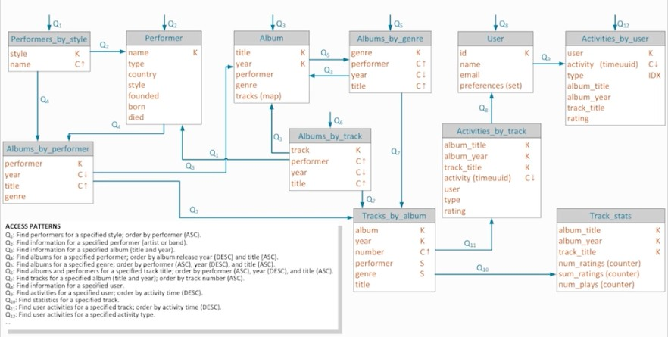
LOGICAL MODEL

Slide 156
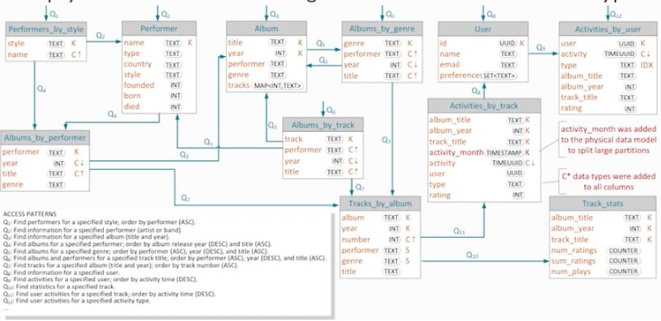
PHYSICAL MODEL

